Slide 1
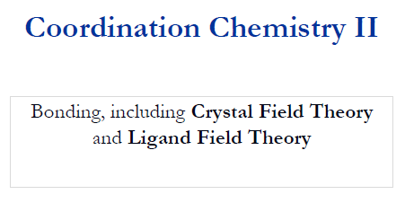

Slide 2
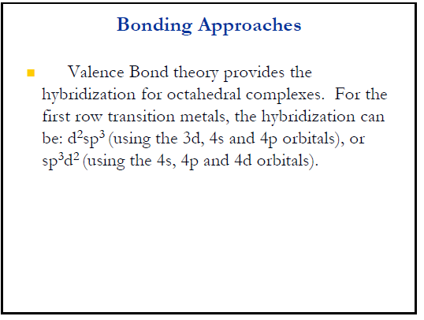

Slide 3
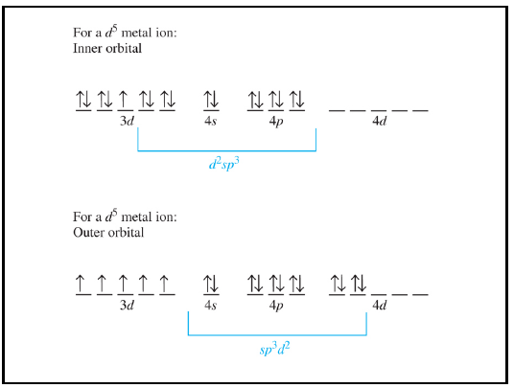

Slide 4
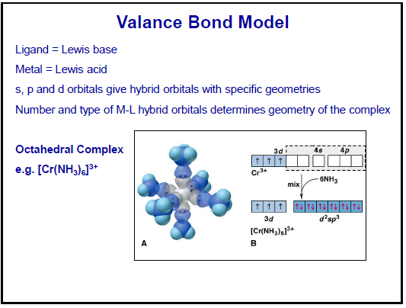

Slide 5
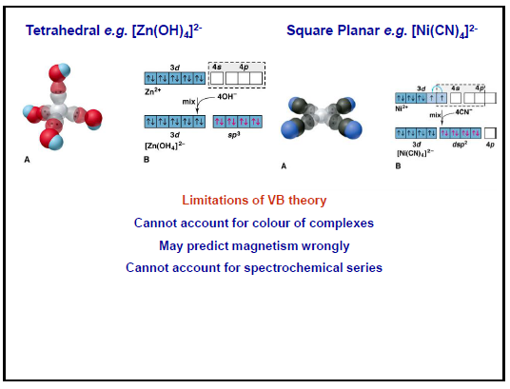

Slide 6
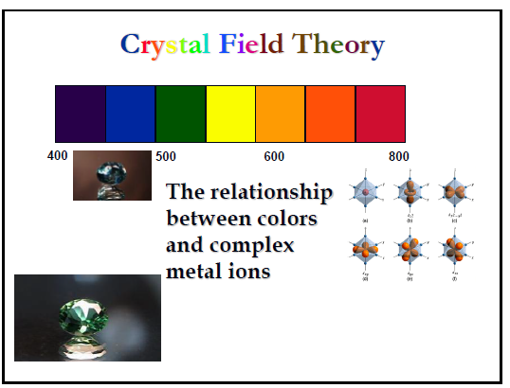

Slide 7
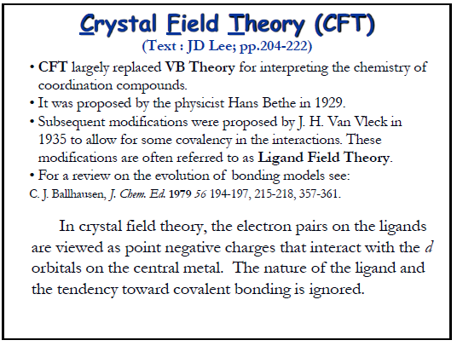

Slide 8
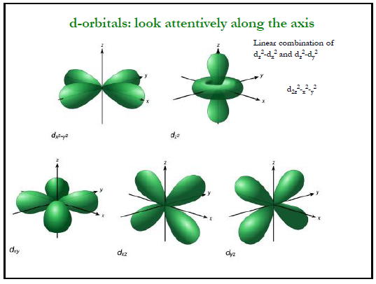

Slide 9
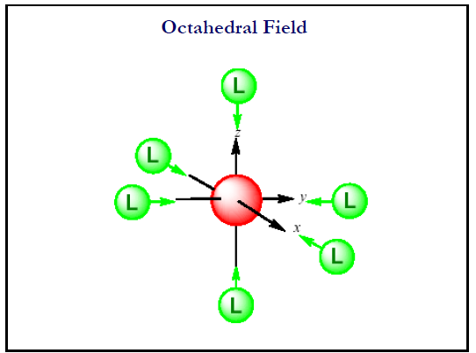

Slide 10
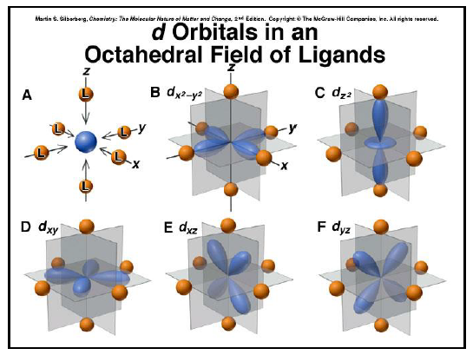

Slide 11
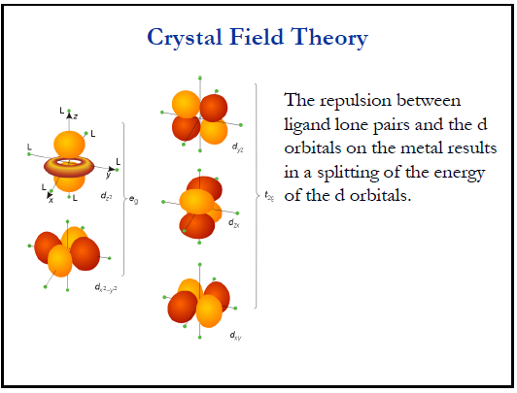

Slide 12
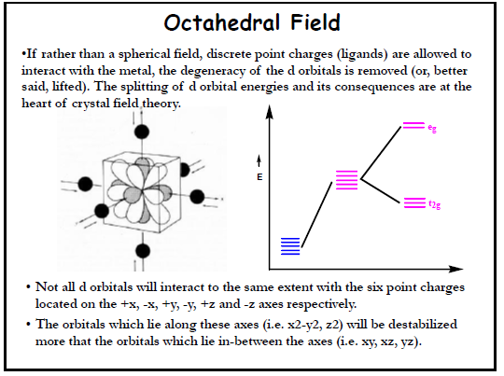

Slide 13
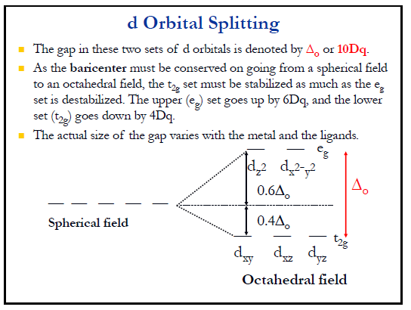

Slide 14
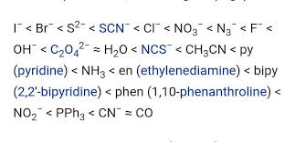
Spectrochemical Series: Ligand Strength

Slide 15
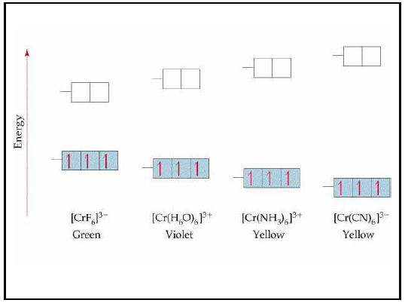
A d³ system: Color change due to ligand interaction with d orbital

Slide 16
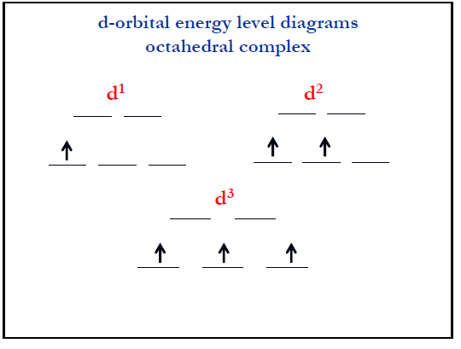

Slide 17
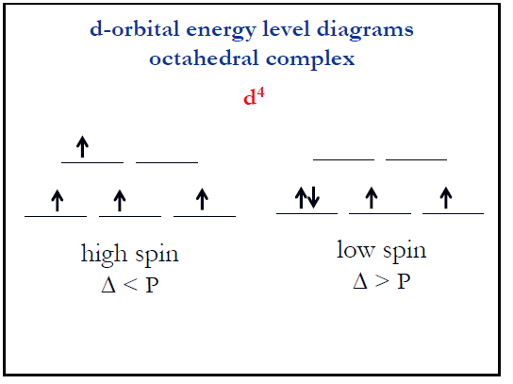

Slide 18
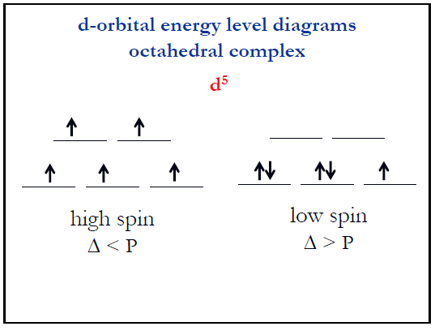

Slide 19
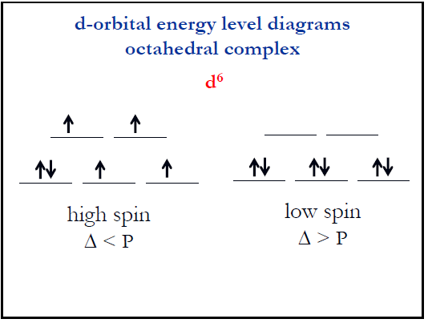

Slide 20
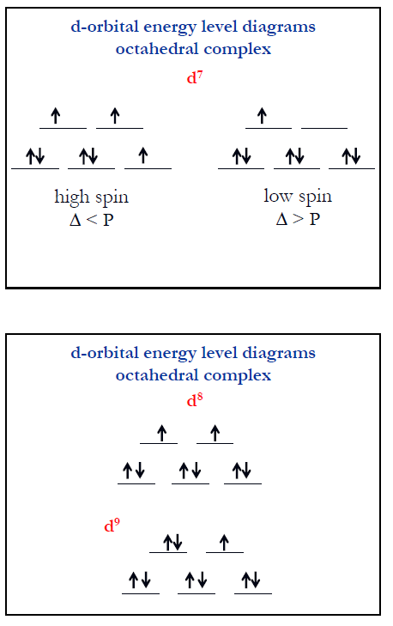

Slide 21
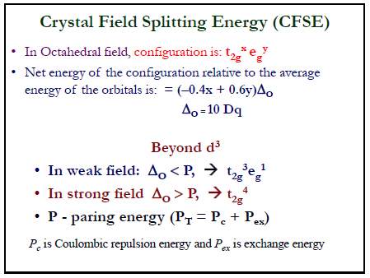

Slide 22
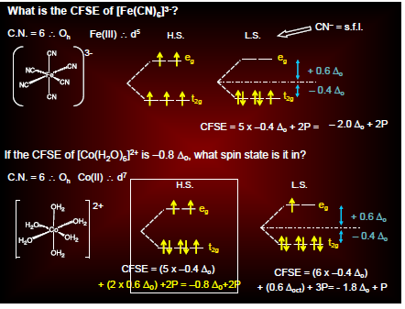

Slide 23
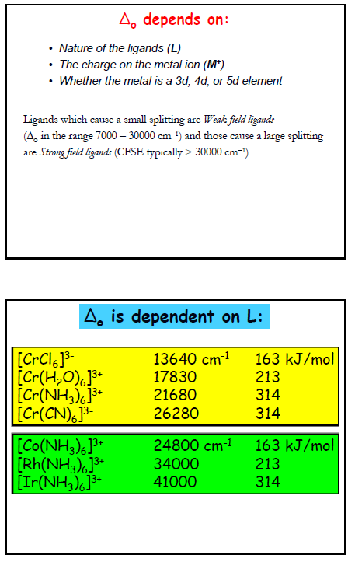

Slide 24
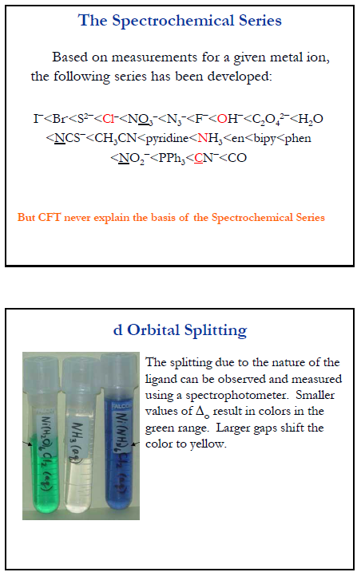

Slide 25
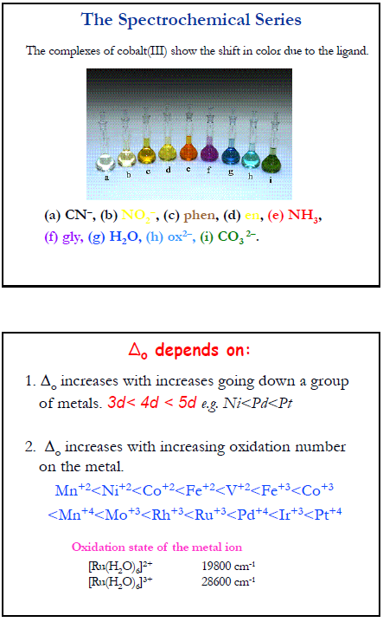
Δ_{o} increases as you go down a group. This is due to the better bonding ability of expanded shells using the 4d or 5d orbitals.
2. Δ_{o} increases with increasing oxidation number of the metal. This is due to the smaller size of the ion, resulting in smaller metal to ligand distances, and hence, a greater ligand field.

Slide 26
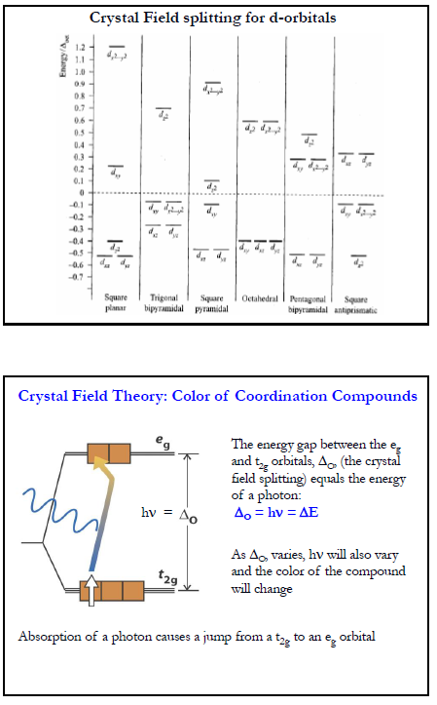

Slide 27
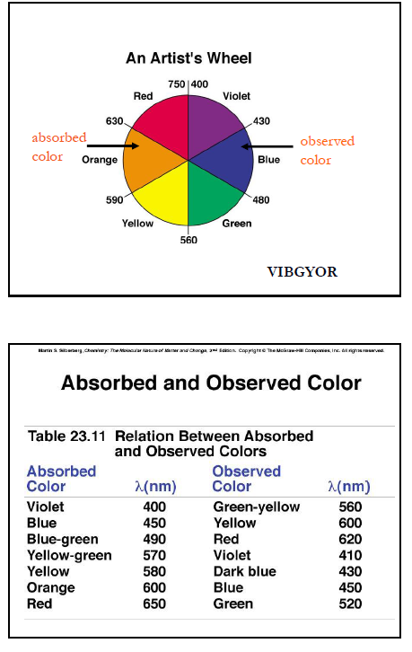

Slide 28
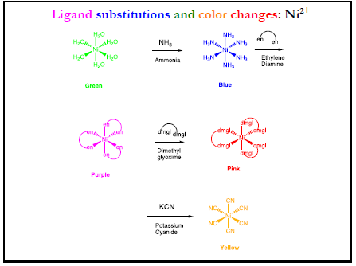
Chelating ligand can form a ring with central metal. Therefore, it has ability to regulate electron within a ring. Because of it there is more force of attraction between central metal ion chelating agent.

Slide 29
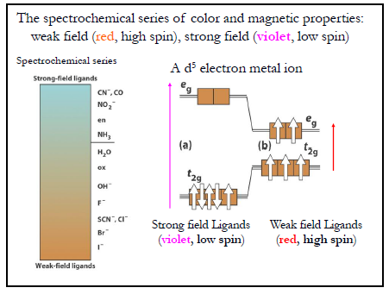
Absorbance

Slide 30
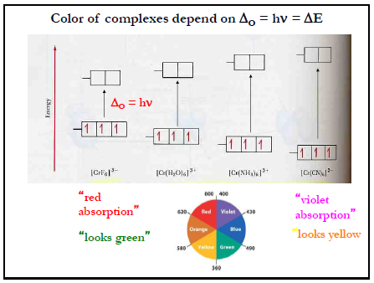

Slide 31
Sources of Colour in TM Complexes
d_{x2-y2}, d_{z2}
d_{xy}, d_{yz}, d_{xz}
e_{g}
3/5 Δ_{o}
Barycenter
2/5 Δ_{T}
Barycenter
Δ_{o}
Δ_{T}
2/5 Δ_{o}
3/5 Δ_{T}
t_{2g}
d_{x2-y2}, d_{z2}
d_{xy}, d_{yz}, d_{xz}
e_{g}
Octahedral Geometry
Tetrahedral Geometry
The colours of TM complexes arise from the absorption of light.
This absorption of light results in d ⇒ d transitions. (movement of the electrons)
G.S
E.S
For [Ti(OH₂)₆]³⁺
e_{g}
e_{g}
Δ_{o} = hv
= 20 300 cm⁻¹
= 493 nm
= 243 kJ/mol
hv
d?
Δ_{o}
Δ_{o}
t_{2g}
t_{2g}

Slide 32
Selection Rules for Electronic Spectra of Transition Metal Complexes
Allowed transitions must involve the promotion of electrons without a change in their spin. ΔS = 0 The Spin Rule
e.g, d³ and d⁵ system
allowed
Not allowed

Slide 33
Selection Rules for Electronic Spectra of Transition Metal Complexes
2. If the molecule has a center of symmetry, transitions within a given set of p or d orbitals are forbidden. Only allowed while changing the dipole moment during transition. Δl = +/- 1 The Orbital Rule (Laporte)
A centrosymmetric molecule has all the wave functions are g or u
s and d orbitals are g g u
p and f orbitals are u u g
All the d-d transitions are forbidden

Slide 34
Relaxation of the Rules
a) Spin-Orbit coupling - this gives rise to weak spin forbidden bands. (angular momentum of both makes new angular momentum J (L+S), partly allow the transition).
b) Lowering the molecular symmetry by vibronic coupling - an octahedral complex may have allowed vibrations where the molecule is asymmetric. Absorption of light at that moment is then possible. (mixing g and u characters of orbitals)
c) π-acceptor and π-donor ligands can mix with the d-orbitals so transitions are no longer purely d-d.

Slide 35
Expected intensities of electronic transitions
Transition type | Example | Typical values of ε /m²mol⁻¹
Spin forbidden, Laporte forbidden | [Mn(H₂O)₆]²⁺ | 0.1
Spin allowed (octahedral complex), Laporte forbidden | [Ti(H₂O)₆]³⁺ | 1 - 10
Spin allowed (tetrahedral complex), Laporte partially allowed by d-p mixing | [CoCl₄]²⁻ | 50 - 150
Spin allowed, Laporte allowed e.g. charge transfer bands | [TiCl₆]²⁻ or MnO₄⁻ | 1000 - 10⁶
Extinction coefficients for tetrahedral complexes are expected to be around 50-100 times larger than for octahedral complexes.

Slide 36
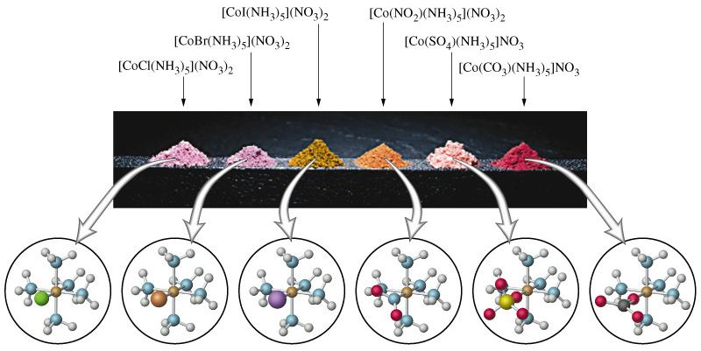
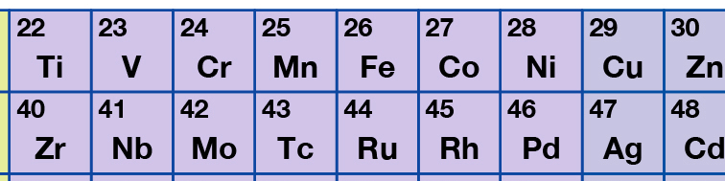
TMs and Colour: Electronic Absorption Spectroscopy.
Where does the colour come from?

Slide 37
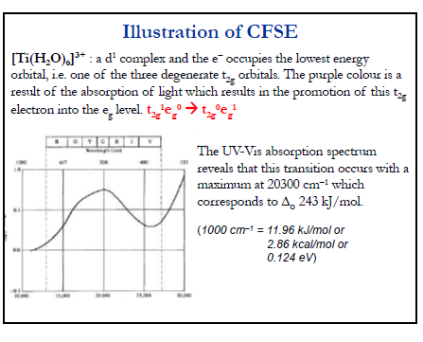
Expected Values The expected values should be compared to the following rough guide. For M²⁺ complexes, expect Δ = 7500 - 12500 cm⁻¹ or λ = 800 - 1350 nm. For M³⁺ complexes, expect Δ= 14000 - 25000 cm⁻¹ or λ = 400 - 720 nm.

Slide 38
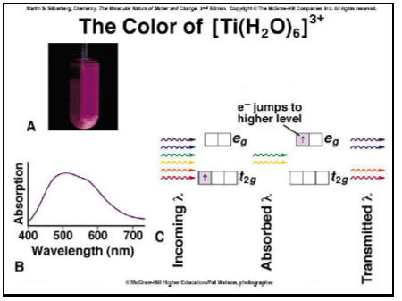

Slide 39
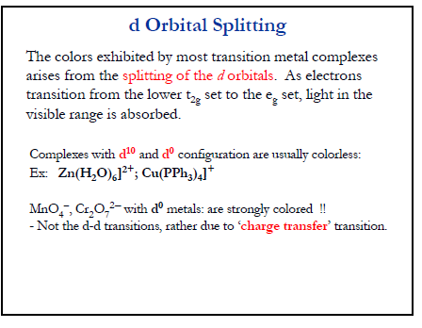

Slide 41
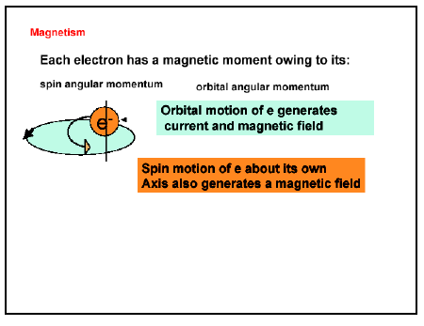
Why is this property important?

Slide 42
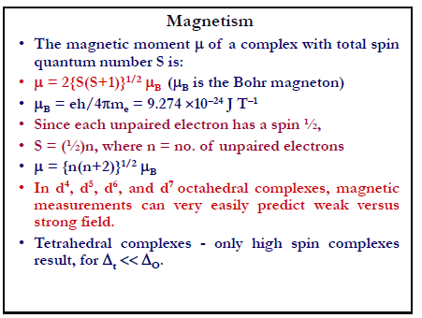

Slide 43
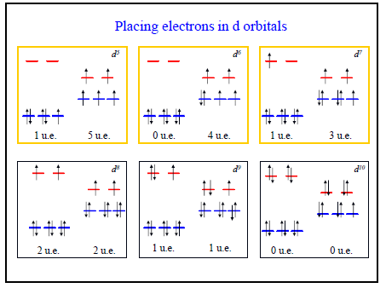
High Spin and low spin complex

Slide 44
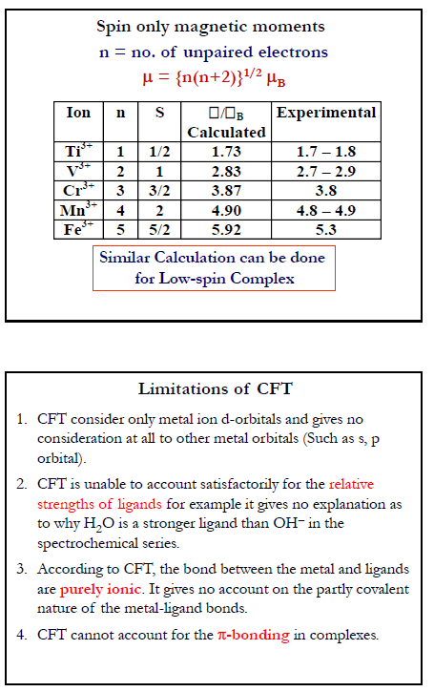

Slide 45
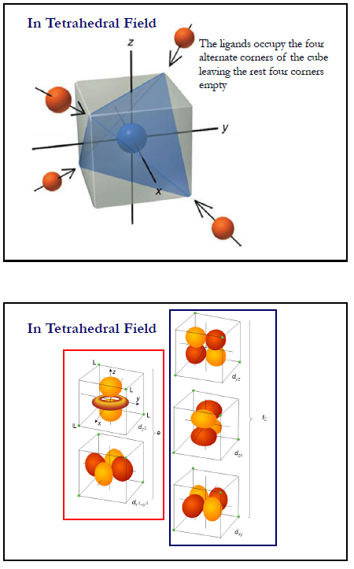

Slide 46
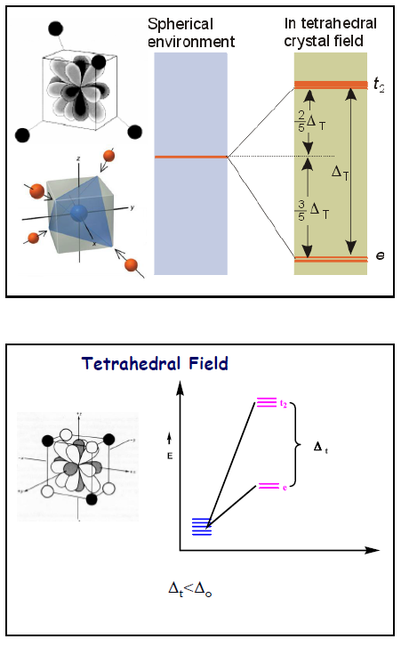

Slide 47
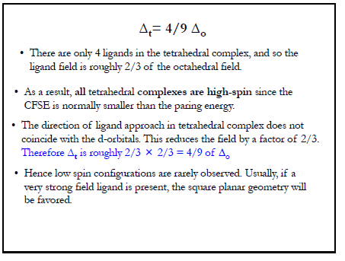

Slide 48
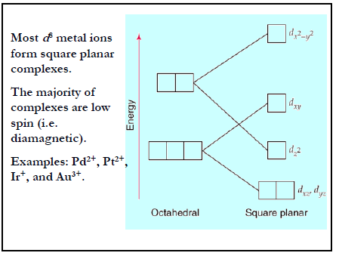
Square planner complex

Slide 49
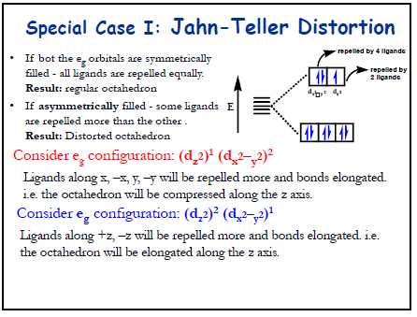

Slide 50
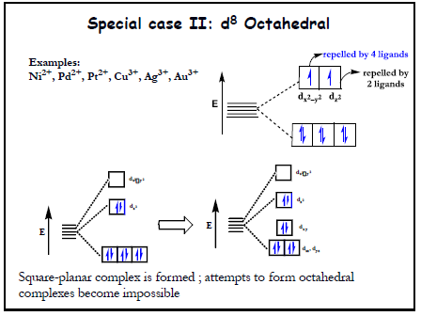
Ligand bias of interaction to dx²-y²

Slide 51
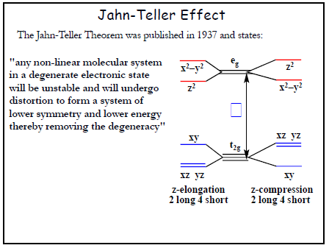

Slide 52
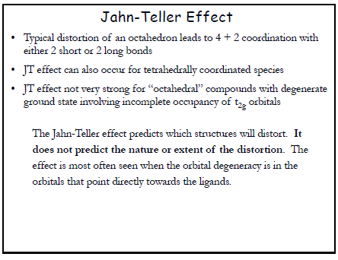

Slide 54
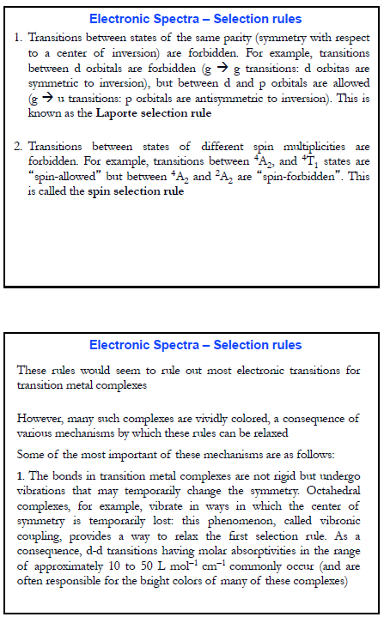

Slide 56
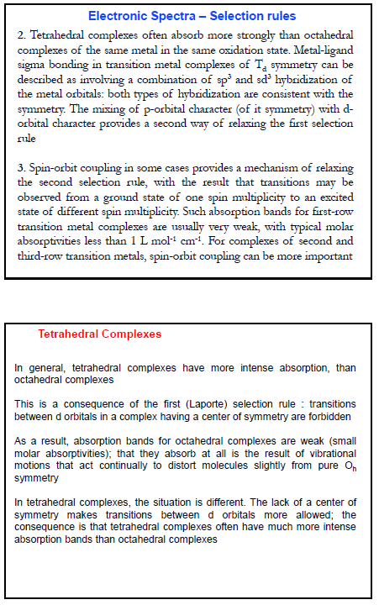

Slide 58
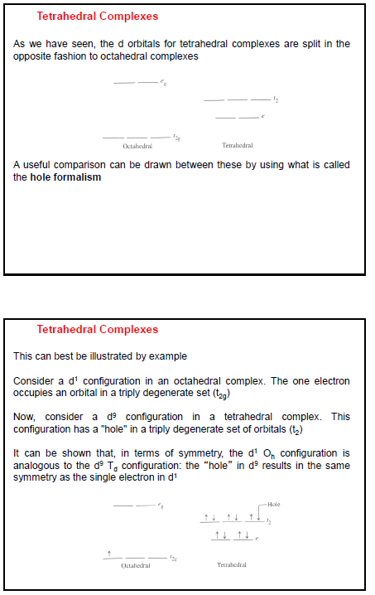

Slide 59


Slide 60


If the ligand molecular orbitals are full, charge transfer may occur from the ligand molecular orbitals to the empty or partially filled metal d-orbitals.

Slide 61


Slide 62


If the metal is in a low oxidation state (electron rich) and the ligand possesses low-lying empty orbitals (e.g., CO or CN−) then a metal-to-ligand charge transfer (MLCT) transition may occur.
[Ru(bpy)₃]Cl₂,

Slide 63
Octahedral complexes such as Cr(CO)₆, have both σ-donor and π-accepting orbitals. They can undergo both types of charge transfer transitions. This makes it difficult to distinguish between LMCT and MLCT.

Slide 64
Spinel Structures.
CFT aids in understanding the arrangements of metal ions in spinel structures.
READ RODGERS WHERE SPINEL STRUCTURES
ARE OUTLINED IN DETAIL. (p. 182-185).
The spinel is a MIXED METAL OXIDE with a general formula (M²⁺)(2M³⁺)(O²⁻)_{4..}
Spinel is MgAl₂O₄
Many compounds adopt this type of structure.
The basic structure is a FCC lattice of O²⁻ anions.
Cations occupy tetrahedral and octahedral holes.
How does CFT help us understand this structure?

Slide 65
Spinel structures and CFT
Normal Spinal Structure.
M²⁺ is tetrahedral, M³⁺ is octahedral Example: (Mg²⁺)_{T}(2Al³⁺)_{O}(O²⁻)₄
Inverse Spinal Structure.
M²⁺ is octahedral M³⁺ is tetrahedral and in the remaining octahedral holes Example: (Fe³⁺)_{T}(Fe²⁺,Fe³⁺)_{O}(O²⁻)₄
This later example is magnetite or Fe₃O₄.
Fe₃O₄ (Fe²⁺, 2Fe³⁺, 2O²⁻)
Note the O²⁻ is a weak field ligand. (Fe is H.S.)
What are the electron configurations of the Fe ions?
Fe⁰ is d⁸
d_{xy}, d_{yz}, d_{xz}
Fe²⁺
d_{x2-y2}, d_{z2}
e_{g}
2/5 Δ_{T}
3/5 Δ_{o}
OR
Δ_{T}
Δ_{o}
2/5 Δ_{o}
3/5 Δ_{T}
t_{2g}
d_{xy}, d_{yz}, d_{xz}
d_{x2-y2}, d_{z2}
e_{g}

Slide 66
Mn₃O₄ Spinel Structure.
Mn₃O₄ (Mn²⁺, 2Mn³⁺, 4O²⁻)
Electron configurations are ….. ?
d_{xy}, d_{yz}, d_{xz}
d_{x2-y2}, d_{z2}
e_{g}
2/5 Δ_{T}
3/5 Δ_{o}
OR
Δ_{T}
Δ_{o}
2/5 Δ_{o}
3/5 Δ_{T}
t_{2g}
d_{xy}, d_{yz}, d_{xz}
d_{x2-y2}, d_{z2}
e_{g}

Slide 67
Inverse Spinel or Spinel
NiFe₂O₄
FeCr₂O₄, Co₃O₄
MFe₂O₄
Check the spinel structure with different metal composition from d¹ to d⁹ system

Slide 69


